Slide 1

The DRY principle
Coding Club
November 4th 2022
Sara Correa Garcia

Slide 2
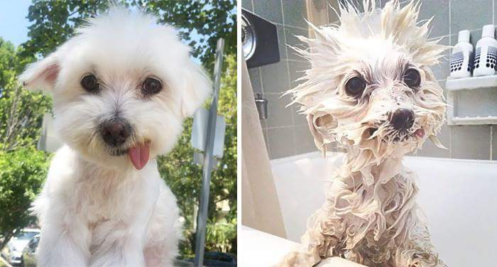

Slide 3

D.R.Y
Don’t Repeat Yourself

Slide 4


Why Dry?
Avoids wasting time
Avoids mistakes
Keep related elements in sync

Slide 5

Don’t get W.E.T.
Write Everything Twice
Write EveryTime
We Enjoy Typing
Waste Everyone’s Time
This Photo by Unknown Author is licensed under CC BY-SA

Slide 6
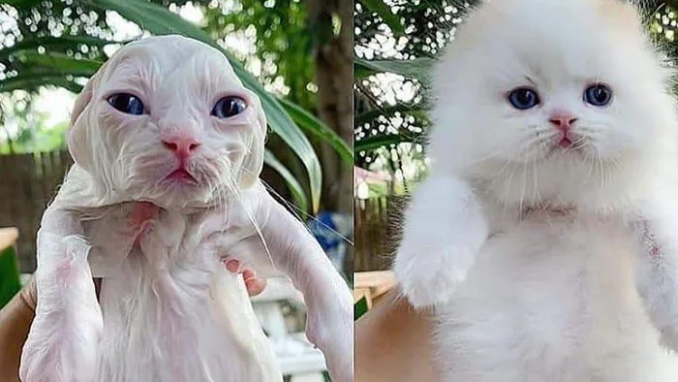
Stay dry!

